Slide 1
DESIGN THINKING
PRESENTATION

Slide 2
TOPIC- PASSWORD AND ACCOUNT MANAGEMENT PAIN POINTS
CONTENTS:-
EMPATHY MAP
BRAINSTORMING
IDEA PRIORITIZATION
HOW MIGHT WE QUESTIONS
STORYBOARDING
SOLUTION RECOMMENDATIONS
SUBMITTED BY - SUYASH SRIJAN

Slide 3
INTRODUCTION
In today’s digital world, our lives are deeply connected to online platforms — from banking and shopping to work and social media. Every one of these activities requires an account, and with each account comes a password. While passwords are meant to protect our personal and professional information, managing them has become a major challenge for most users.
People struggle to remember dozens of complex passwords, fall into unsafe habits like reusing the same one across multiple sites, or rely on insecure methods to store them. On the other hand, organizations face increasing security risks, data breaches, and support costs due to poor password management practices.
This presentation will explore the common pain points associated with password and account management, understand why these issues persist, and discuss strategies and tools that can make the process more secure and user-friendly.

Slide 4
AIM OF THE TOPIC
The aim of this topic is to thoroughly examine the various pain points and challenges associated with password and account management in both personal and organizational contexts. It seeks to highlight the difficulties users face in creating, remembering, and securely managing multiple passwords, as well as the security risks and operational burdens that arise from poor password practices. Furthermore, this topic aims to explore the underlying causes of these issues, assess their impact on data protection and user experience, and identify practical strategies, tools, and modern authentication methods that can improve password security, simplify account management, and reduce the likelihood of breaches and unauthorized access.

Slide 5
EMPATHY MAP
An Empathy Map is a tool used to understand what a user thinks, feels, says, and does. It helps us step into the user’s shoes and see the world from their point of view.
STEPS:-
DOES- Reuses the same password across multiple accounts.
THINKS-“I’m worried about my accounts getting hacked.”
FEELS-Frustrated by complex password requirements.
SAYS-“I can’t remember all my passwords.”

Slide 6
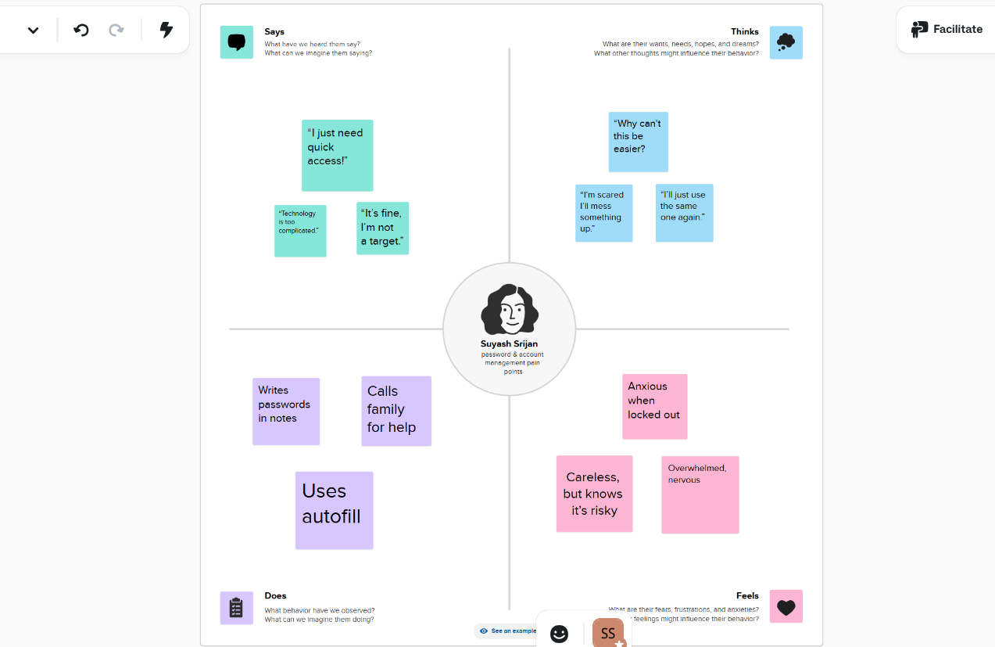
EMPATHY MAP

Slide 7
HOW MIGHT WE(HMW)
A “How Might We” (HMW) statement is a design thinking tool used to turn a problem or challenge into an opportunity for innovation. It helps us reframe issues in a positive and solution-focused way. Instead of asking “Why is this a problem?” we ask “How might we solve it?”
The phrase starts with “How”, which suggests that a solution is possible; “Might”, which opens up many possibilities and encourages creativity; and “We”, which shows collaboration and teamwork.
For example, if users struggle to remember complex passwords, we can ask:
👉 “How might we make password management easier and more secure for users?”
By asking these kinds of questions, teams can brainstorm new ideas, explore different perspectives, and develop solutions that truly address user needs. “How Might We” statements are especially useful after identifying pain points through tools like empathy maps.

Slide 8
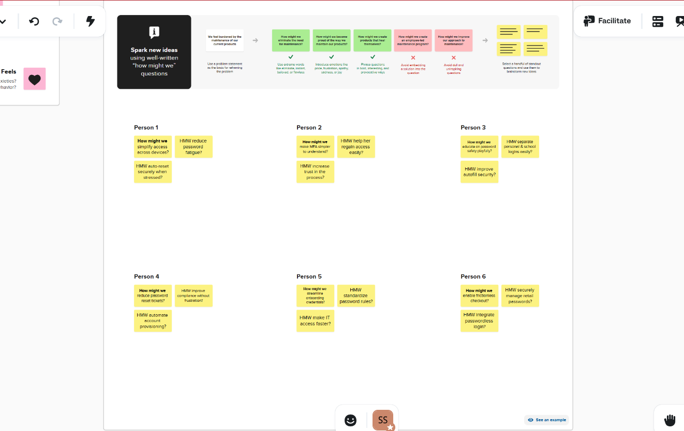
HOW MIGHT WE (HMW)

Slide 9
BRAINSTORMING
Brainstorming is a creative problem-solving technique used to generate a wide range of ideas and solutions in a short period of time. It encourages free thinking and open discussion, allowing participants to explore many possibilities without immediately judging or criticizing them. The main goal of brainstorming is quantity first, quality later—the more ideas generated, the higher the chance of finding an innovative or effective solution.
Key aspects of brainstorming include:
Encouraging creativity: Everyone is encouraged to contribute ideas, no matter how unconventional they may seem.
Deferring judgment: Criticism is avoided during idea generation to allow creativity to flow freely.
Building on ideas: Participants can combine, improve, or adapt others’ ideas to create stronger solutions.
Diverse perspectives: Involving people with different experiences and expertise often leads to richer ideas.

Slide 10
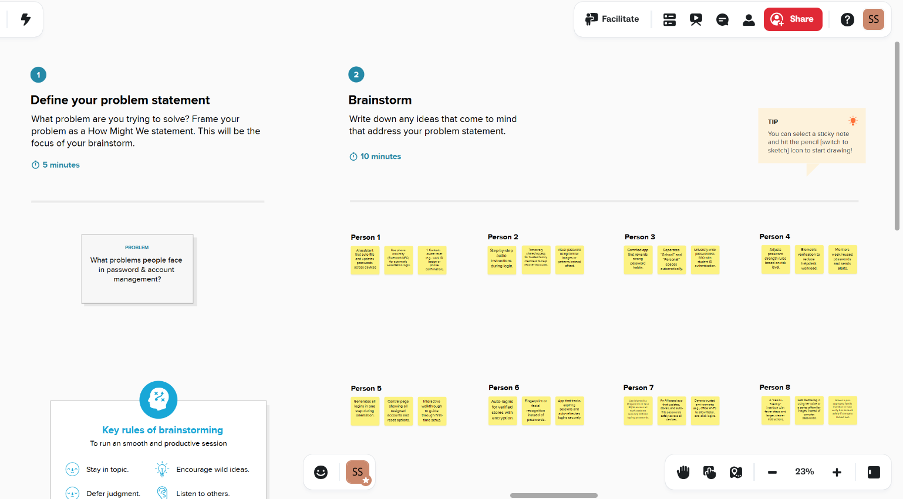
BRAINSTORMING

Slide 11
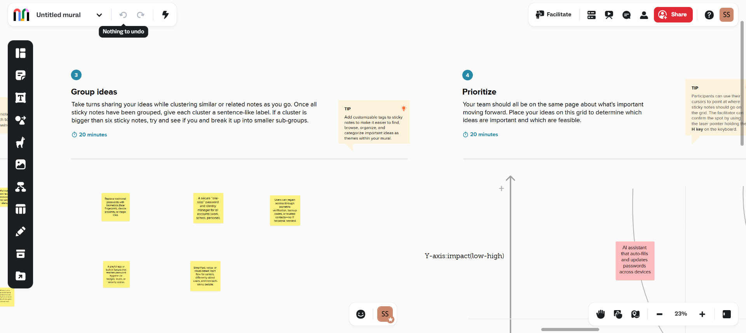
IDEA PRIORITIZATION

Slide 12
STORYBOARDING
Storyboarding is a visual method used to plan and present the user’s journey or experience step by step. It is like a comic strip that tells a story — showing how a user interacts with a product or system, what problems they face, and how possible solutions can improve their experience.
In password and account management, storyboarding helps visualize the challenges users go through when trying to log in, reset passwords, or manage multiple accounts. It also helps designers and developers understand users’ emotions and identify points where the experience can be improved.
A storyboard usually includes:
Scenes or steps: Key stages in the user’s experience (e.g., creating an account, forgetting a password, resetting it).
Characters: The user or person experiencing the problem.
Actions: What the user is doing at each step.
Emotions: How the user feels — frustrated, confused, or relieved.
Possible solutions: Ideas that could make each step easier or more secure.

Slide 13
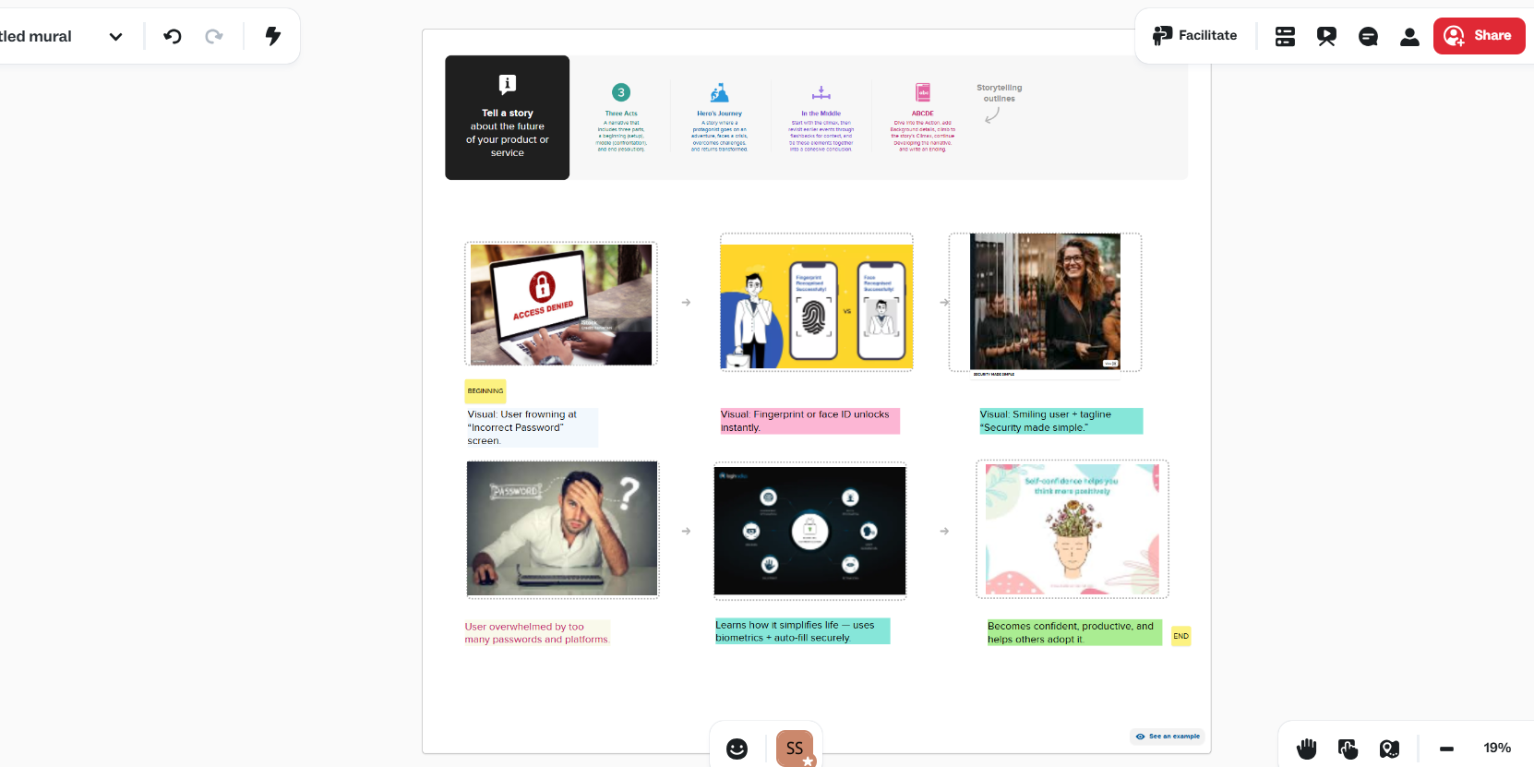
IN MURAL,

Slide 14
SOLUTION RECOMMENDATIONS
Use of Password Managers
Encourage users to store and manage all their passwords securely in one place.
Password managers can automatically generate strong, unique passwords for every account.
Examples: LastPass, 1Password, Bitwarden.
Implement Multi-Factor Authentication (MFA)
Add an extra layer of security through verification codes, biometrics, or hardware tokens.
Reduces the risk of unauthorized access even if a password is stolen.
Simplify Password Policies
Balance security with usability by avoiding overly complex or frequent password changes.
Use passphrases (e.g., “BlueSky!RunsFast2025”) that are strong but easy to remember.
Educate Users on Cybersecurity Practices
Conduct regular awareness sessions or online training.
Teach users how to create secure passwords, spot phishing attempts, and avoid unsafe storage habits.
Adopt Passwordless Authentication
Introduce modern login options like fingerprint, face recognition, or single sign-on (SSO).
Improves convenience and reduces password fatigue.

Slide 15
THANK YOU

